Slide 1
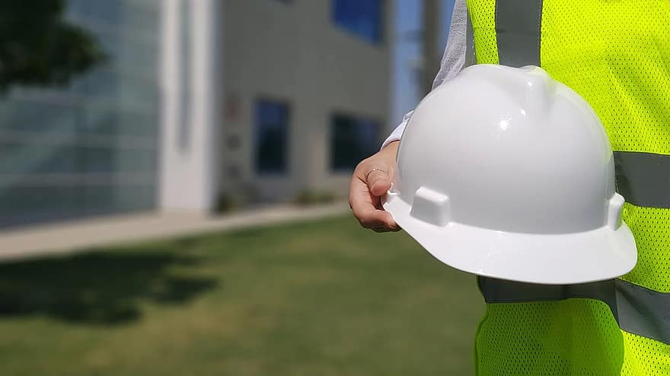
The IOT-Powered Smart Helmet

Slide 2
CONTENTS

Slide 3
Introduction to IOT Based Smart Helmet
The IOT based smart helmet is designed to provide industrial workers with a safe and secure working environment. It is equipped with a variety of sensors and features that can help monitor and protect workers from potential hazards. The helmet is also equipped with a communication system to enable workers to communicate with each other and with their supervisors.
The helmet is designed to be lightweight and comfortable to wear, allowing workers to work in a safe and comfortable environment. It is also designed to be waterproof and dust-proof, providing protection from the elements. Additionally, the helmet is designed to be low-maintenance and easy to use, allowing workers to focus on their tasks without worrying about the helmet's upkeep.

Slide 4
Features of IOT Based Smart Helmet
The IOT based smart helmet is equipped with a variety of features that help to protect and monitor workers. These features include a built-in microphone and speaker system, allowing workers to communicate with each other and with their supervisors. Additionally, the helmet is equipped with a variety of sensors, such as an accelerometer, gyroscope, and temperature sensors, which can help to monitor the worker’s environment and detect potential hazards.
The helmet also includes a GPS system, allowing workers to be tracked in case of an emergency. Additionally, the helmet is equipped with a variety of safety features, such as a warning system that can alert workers to potential dangers, and a headlamp that can be used to illuminate dark areas. Finally, the helmet is designed to be low-maintenance and easy to use, allowing workers to focus on their tasks without worrying about the helmet's upkeep.

Slide 5
Sensor Used
Temperature Sensor
Humidity Sensor
Gas Sensor
Arduino

Slide 6
Benefits of IOT Based Smart Helmet
The helmet is designed to be lightweight and comfortable to wear, allowing workers to work in a safe and comfortable environment.
The helmet is waterproof and dust-proof, providing protection from the elements.
The helmet is also equipped with a variety of sensors and features that can help monitor and protect workers from potential hazards.
The helmet also includes a GPS system, allowing workers to be tracked in case of an emergency.
Additionally, the helmet is equipped with a variety of safety features, such as a warning system that can alert workers to potential dangers, and a headlamp that can be used to illuminate dark areas.
The helmet is designed to be low-maintenance and easy to use, allowing workers to focus on their tasks without worrying about the helmet's upkeep.

Slide 7
Applications of IOT Based Smart Helmet
The IOT based smart helmet can be used in a variety of industries and applications. It can be used in factories, construction sites, and other industrial settings to protect workers from potential hazards. Additionally, the helmet can be used in mining operations to help monitor and protect workers from hazardous conditions. The helmet can also be used in emergency situations, such as fires or natural disasters, to help locate and rescue workers.
The helmet can also be used in research and development operations, allowing researchers to monitor and track data in real-time. Additionally, the helmet can be used in virtual reality applications, allowing users to experience virtual environments in a safe and secure manner. Finally, the helmet can be used in a variety of other applications, such as military operations, law enforcement, and search and rescue operations.

Slide 8
Conclusion
The IOT based smart helmet is an innovative and effective tool for protecting and monitoring industrial workers. It is designed to be lightweight and comfortable to wear, allowing workers to work in a safe and comfortable environment. Additionally, the helmet is equipped with a variety of sensors and features that can help monitor and protect workers from potential hazards. Finally, the helmet is designed to be low-maintenance and easy to use, allowing workers to focus on their tasks without worrying about the helmet's upkeep.
The IOT based smart helmet can be used in a variety of industries and applications, including factories, construction sites, mining operations, research and development, virtual reality applications, and military operations. The helmet can help to protect and monitor workers, as well as provide a safe and secure working environment. Ultimately, the IOT based smart helmet can help to ensure that industrial workers are safe and secure while on the job.

